Slide 1
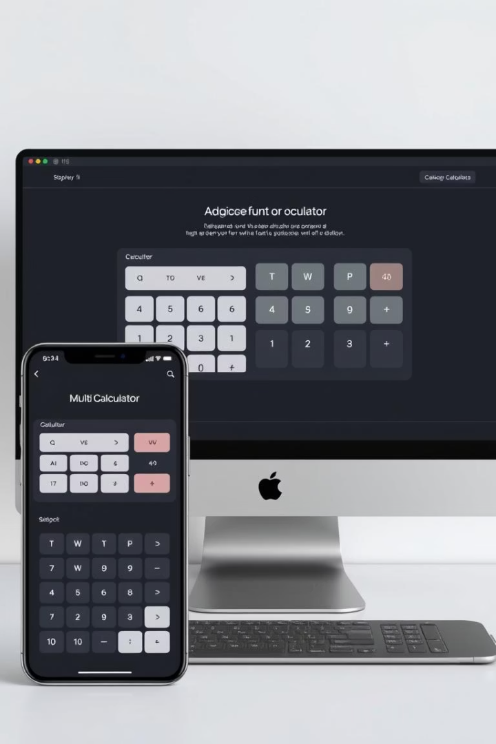
Responsive Multi-Calculator Web App: A Frontend Showcase
This web application, built with React, TypeScript, and CSS, showcases advanced frontend development skills.

Slide 2
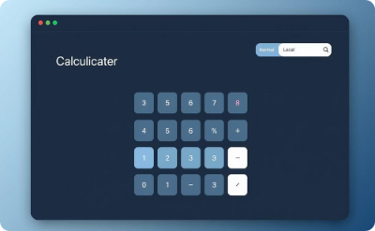
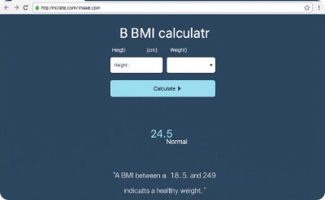
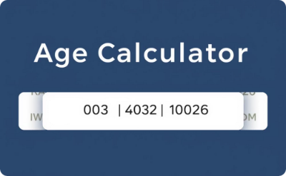
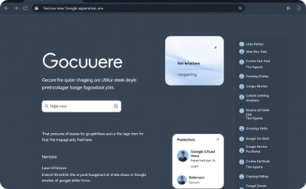
Project Overview & Core Features
Normal Calculator
BMI Calculator
Age Calculator
Google-Style UI & Dark Theme
Standard arithmetic operations.
Calculates Body Mass Index.
Determines age from birth date.
Familiar, intuitive interface with reduced eye strain.

Slide 3





Frontend Architecture: React & TypeScript
Modular Components
Reusable React components.
State Management
Manage data with React Hooks.
TypeScript Benefits
Stronger code with type safety.
Functional Code
Clean code with modern React.

Slide 4
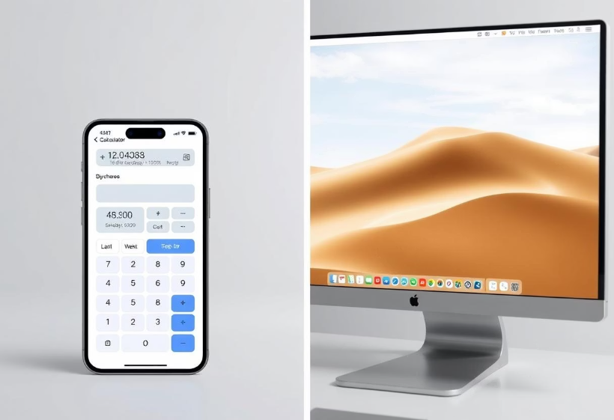
Seamless Responsiveness & UI/UX
CSS Flexbox & Grid: Creates flexible layouts that adapt.
Media Queries: Styles change for different screen sizes.
Mobile-First Approach: Designed for small screens first, then larger ones.
Pixel-Perfect Scaling: Layout adjusts perfectly without stretching.

Slide 5

Key Learnings & Challenges Overcome
1
Complex State
Managing how different parts of the calculator work together.
2
Browser Compatibility
Making sure the app works the same on all web browsers.
3
Accessibility
Making the app easy for everyone to use, including those with disabilities.
4
Performance
Making the app fast and smooth by reducing unnecessary updates.

Slide 6

Conclusion: Skills Demonstrated & Future Scope
Demonstrated Skills
React, TypeScript, CSS, Responsive Design, UI/UX.
Component Design
Reusable and scalable architecture.
Future Enhancements
Currency converter, unit converter, scientific calculator.

